Slide 1
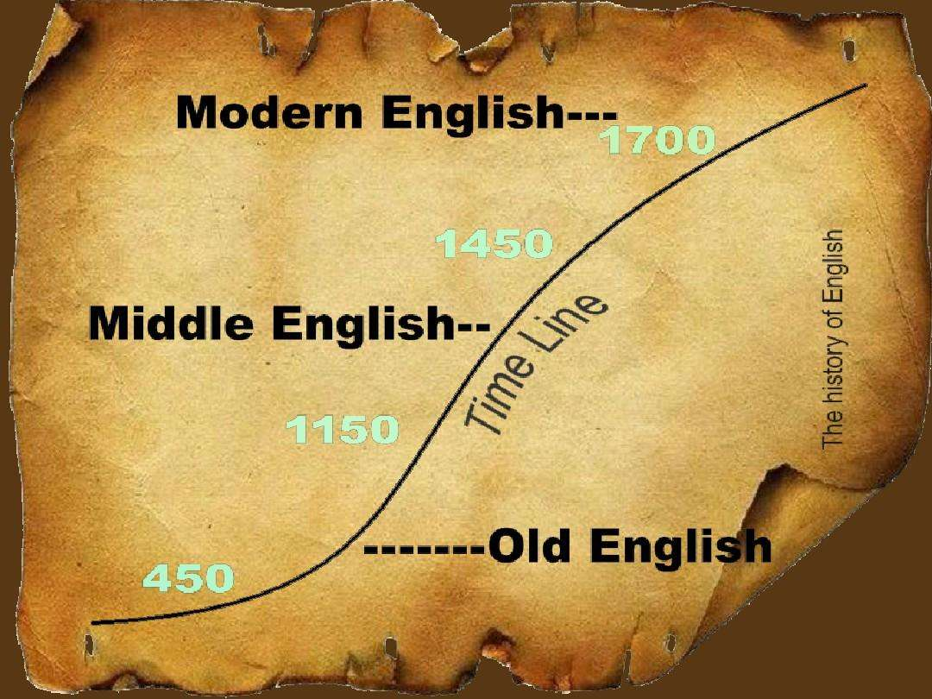
Unit 1
Text A: A Brief History of English

Slide 2
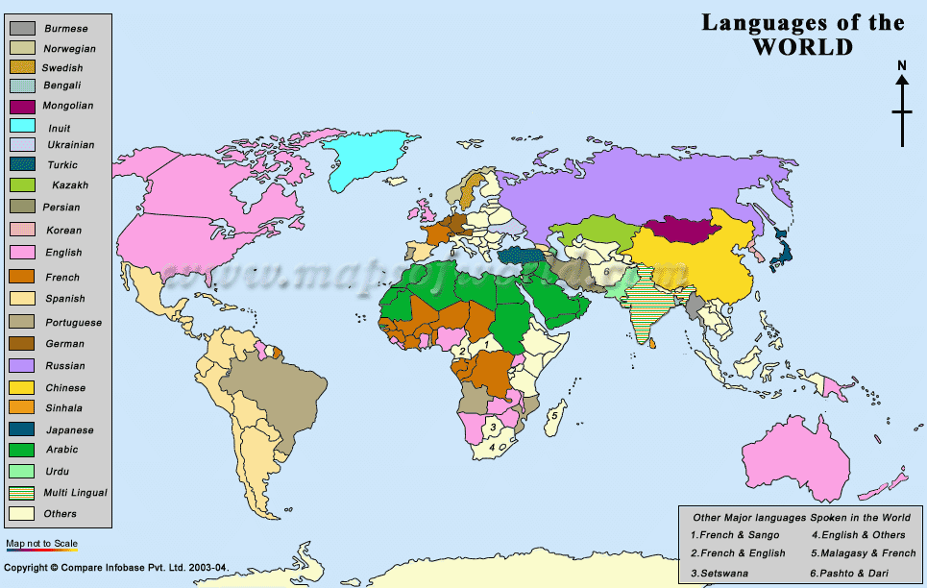
Language of the World

Slide 3
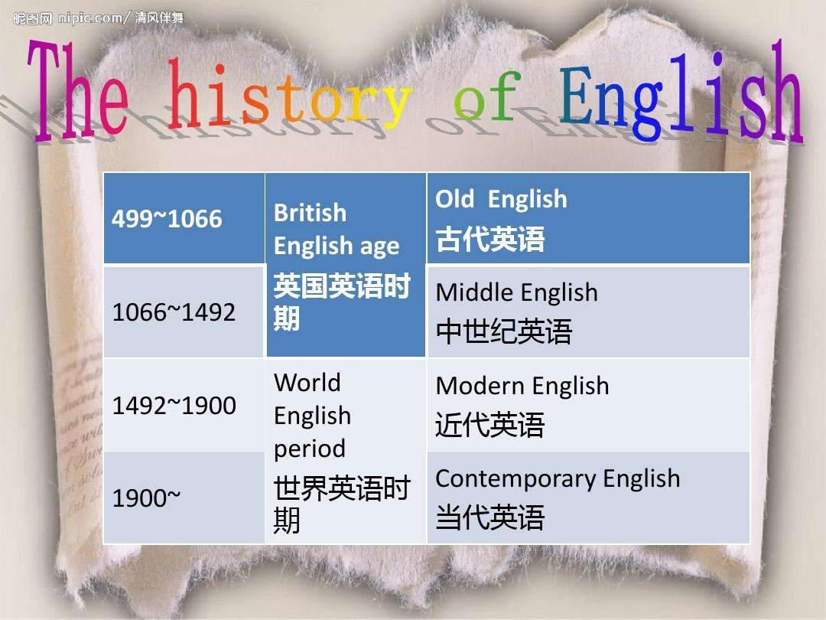
The history of English

Slide 4
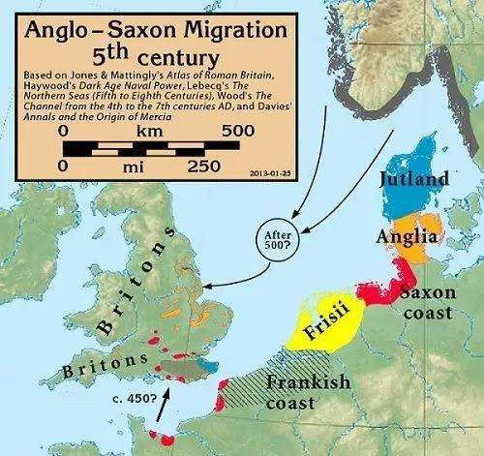
Anglo-Saxon Migration

Slide 5
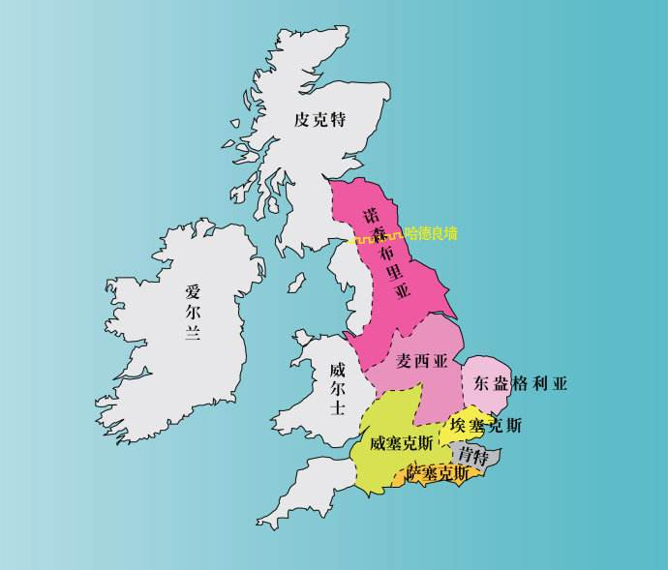
Seven kingdoms

Slide 6
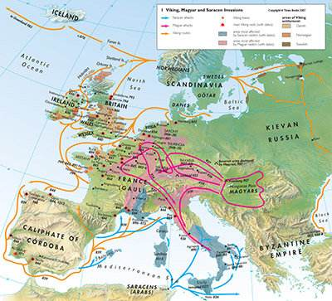
Viking Invasion

Slide 7
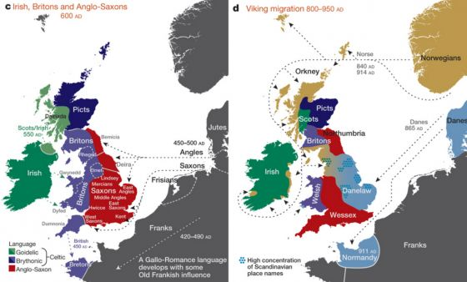
Viking Invasion

Slide 8
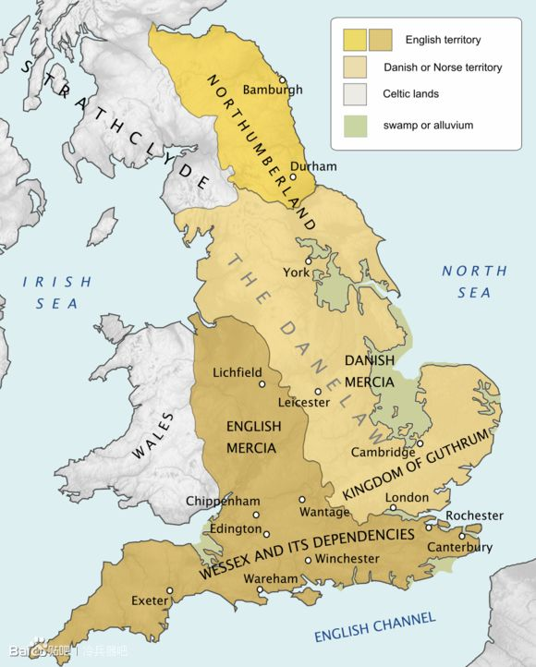
Viking Invasion

Slide 9
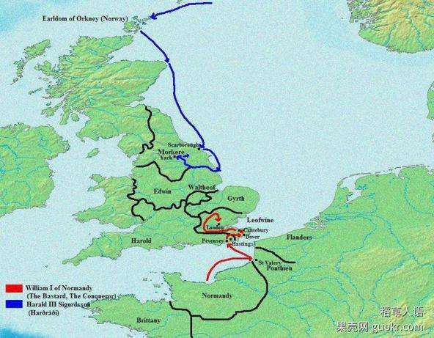
Norman Conquest

Slide 10
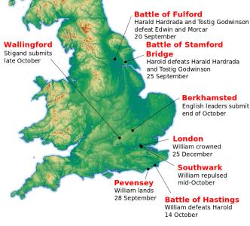
Norman Conquest

Slide 11
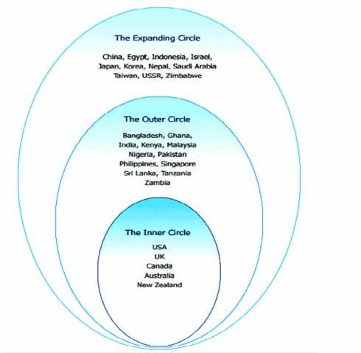
Circles of English

Slide 12
Language point
satisfactory: good enough to meet a requirement or to be considered acceptable 令人满意的
fairly/highly satisfactory
The answer was not satisfactory to him.
Do you think that he is satisfactory for the job? 适合
We are satisfied with the results.
to express/feel satisfaction
The work was done to my satisfaction.

Slide 13
Language point
double negative 双重否定
Humans can’t live without water.
I am not unconvinced.
It is not unusual/uncommon that humans tell lies.

Slide 14
Language point
notion: an idea, opinion, or concept 观念；想法
to have a notion
a foggy/hazy/vague notion 模糊的想法
He did not have the slightest notion of what I meant.
She had a notion to go abroad.
to inhabit a notional world 生活在空想世界里

Slide 15
Language point
make do with: to use something that is an unsatisfactory substitute or temporary alternative for the real thing 将就着用；凑合着用
to make do with biscuits for lunch
During the war we had no butter or coffee, but we made do.
He could make one shirt do for one week.
We can make do without Middle Eastern oil, but they cannot.

Slide 16
Language point
complicated: difficult to understand, deal with, or explain 复杂的（内容难以理解，应对）
Life is complicated enough as it is.
It all sounds very complicated.
This is where the story gets complicated.
to cause complications 引起纠纷/麻烦事
to avoid complications
Complications arise/set in.
She developed complications two weeks after the treatment. 并发症

Slide 17
Language point
hit the high spots: to focus or touch on the most important points or things (informal) 关注最重要的事情
In his lecture he hit the high spots of his subject.
They went to the fair for one day and hit only the high spots.
the high spots of a book/lecture/show

Slide 18
Language point
A.D. (Anno Domini): used to indicate a date that is a particular number of years after the birth of Jesus Christ. 公元
from 300 B.C. to A.D.400
Because of its literal Latin meaning, "in the year of the Lord," A.D. is traditionally put before the numeral to which it relates, so that it makes grammatical sense if understood in its expanded form: A.D. 1453. In practice, A.D. is usually put after the numeral, and it is also acceptable to put it after the identification of a century, as in the fifth century A.D. Some writers prefer to use p.e. (Present Era) or c.e. (Common Era) as alternatives in order to avoid the association with Christianity.

Slide 19
Language point
prehistory: the period before history was first recorded in writing 史前史
prehistory of Chinese civilization
the prehistory of existing racial relations 背景
prehistoric burial ground 史前墓地

Slide 20
Language point
ancestor: somebody from whom somebody else is directly descended, especially somebody more distant than a grandparent 祖先
common/remote(远祖) ancestor
to trace one’s ancestry 追溯祖先
to be of French ancestry 法国血统
ancestral grave/portraits/estate

Slide 21
Language point
Anglo-Saxon: a member of a West Germanic people who settled in Britain from the 5th century ad and were dominant until 1066. They included the Angles, Saxons, and Jutes. 盎格鲁撒克逊人
Anglo-sphere: English-speaking nations such as Britain, Australia, and New Zealand and their lands, territories, heritages, and common political, economic, and security interests 英语圈
Anglophile: an admirer of England or English people 仰慕英国的人
Anglophobe: somebody who hates England or English people 讨厌英国的人
Anglophone: somebody who speaks English, especially as a first language 母语为英语的人

Slide 22
Language point
Angle: a member of a Germanic people who invaded and settled eastern and northern England in the 5th and 6th centuries A.D. 盎格鲁人
Saxon: a member of a West Germanic people who started to spread west during Roman times, establishing powerful kingdoms with the Angles in southern Britain in the 7th century A.D.撒克逊人
Jute: a member of a Germanic people from around the Rhine estuary who invaded southeastern England during the fifth century ad. They settled in Kent and the Isle of Wight, where they soon became the dominant people. 朱特人

Slide 23
Language point
wander: to follow a winding course 漫游；蜿蜒
The river wandered through the meadows.
to wander from the subject
The children wandered away from their parents.
homeless wanderer

Slide 24
Language point
Germanic: a group of languages spoken across northwestern Europe that forms a branch of Indo-European. 500 million. 日尔曼的；德意志的
Germanic regard for order 德国人对秩序的重视

Slide 25
Language point
Indo-European: a large family of languages spoken from South Asia to Western Europe and the United States, comprising the Balto-Slavonic, Germanic, Italic, Indo-Iranian, Celtic, Greek, Albanian, Armenian, Anatolian, and Tocharian branches. This language family includes many modern languages such as Bangla, English, French, German, Spanish, Russian, Hindi, and Urdu. 印欧语系

Slide 26
Language point
arrival: the reaching of a place after coming from another place 到达
Her arrival caused a buzz of comment. 热烈评论
On our arrival in Chicago, we called him. 一到……就……
to arrive early/late/on time
to arrive in/at
They arrived from Paris.
They arrived safe and sound.

Slide 27
Language point
secure: to make a building or area safe to occupy, usually by ensuring that all internal sources of danger are removed or that it is defended against attack 巩固；确保
to secure borders against attack
to secure the house from burglary
You are secure from danger here.
a feeling/sense of security
social security
to issue securities 债券
corporate securities

Slide 28
Language point
go on: to continue to happen 持续
The dispute went on for another nine months before it was resolved.
I went on up the hill.
The range of mountains seems to go on for ever.
Go on with your work.
He went on smoking.
Having read lesson one, I went on to read lesson two.

Slide 29
Language point
as/as long as: on condition that 只要（表示条件）
You can go out, as long as you promise to be back before 11 o’clock.
You can succeed so long as you work hard.

Slide 30
Language point
Celt: a member of an ancient Indo-European people who lived in central and western Europe. They were driven to the western fringes of the continent by the Romans and some Germanic peoples, especially the Angles and Saxons. 凯尔特人

Slide 31
Language point
Wales: principality in Great Britain, part of the United Kingdom. Once a separate kingdom, it was united with England in 1536. It voted in 1997 to have its own assembly, and as a result has a degree of self-government. 威尔士
Capital: Cardiff
Population: 2,952,000 (2004 estimate)
Area: 20,760 sq km/8,015 sq mi

Slide 32
Language point
reduce: to bring somebody or something into a particular undesirable state 沦为；减少
Bombing had reduced the town to rubble.
She was reduced to poverty.
The pen was reduced from 50 yuan to 20 yuan.
He objected to the reduction of the whole issue to a single question.

Slide 33
Language point
slavery: the practice of, or a system based on, using the enforced labor of other people 奴隶制度；奴役
to establish/introduce/abolish slavery
to free sb. from slavery
to slave over a hot stove 在热火炉边拼命干活
to slave at a job
fugitive/runaway slave
a slave to a habit

Slide 34
Language point
mythological: relating to, typical of, or appearing in myth 神化的
The phoenix is a mythological bird.
comparative mythology
to accept the official mythology 鬼话
to create/believe a myth
to debunk/explode/dispel a myth 揭穿骗人的把戏

Slide 35
Language point
Romanize: to take on Roman characteristics, or make somebody or something take on Roman characteristics 罗马化
the Romanized Celts
the Roman period
Roman simplicity (fortitude and virtue)

Slide 36
Language point
temporary: lasting or designed to last for a limited time 暂时的；临时性的
temporary building/bridge
temporary relief from pain
temporary excitement
We need several temporaries as typists.

Slide 37
Language point
or so: more or less 大约
It will cost only 15 yuan or so.
a day or so
a glass or so of beer

Slide 38
Language point
firm: fixed securely and unlikely to give way 牢固的；坚定的
a firm hold
firm muscle
as firm as a rock
The pound was firm against the dollar.
to be firm with the children 严格

Slide 39
Language point
established: legally recognized and sometimes financially supported as an official national institution 确立的；确定的
an established church
He established himself as the most popular minister in the new cabinet. 确定
The press established him as the leading contender.
He has established himself in the team.
The police established that she was innocent. 证实

Slide 40
Language point
customary: conforming to what is usual or normal 惯例的；惯常的
It is customary for them to get up early.
It is customary to tip the waiter.
to establish/practice a custom
an ancient/old/local custom

Slide 41
Language point
Old English: the earliest form of the English language, used up to about ad 1150. It was first written using the runic alphabet. 古英语
Middle English: the form of the English language spoken and written between the 12th and the beginning of the 16th centuries. The leading dialects of this period were Kentish(肯特), West Saxon(西撒克逊), West Midland(中西部), East Midland, and Northern(北部). 中古英语
Modern English: the English language from about 1500, when it began to develop a more standardized form compared with the dialects of Middle English. Modern English developed mainly from the East Midland(中东部) dialect, and the standardization process was accelerated by the introduction of the printing press during the 1470s. 现代英语

Slide 42
Language point
divide: to separate or split something into two or more parts, or be separated or split into parts 划分
to divide sth. equally/evenly 平均分配
to divide six by three
They divided the loot into equal shares.
The road divides into two here. 分叉
We are sharply divided over this issue. 严重分歧
to cross the dividing line

Slide 43
Language point
more or less: approximately 大致；或多或少
The repairs to the car will cost 50 dollars, more or less.
He more or less thought it was his duty to tell me the truth.
They were more or less willing to help.
The work is more or less finished.

Slide 44
Language point
autonomous: politically independent and self-governing 自治的
fully/totally autonomous
full/local autonomy
a demand for autonomy
Although officially a dependent territory the island is effectively autonomous.
politically autonomous
autonomous region 自治区
automatic pilot
automobile 汽车

Slide 45
Language point
at times: sometimes 有时候
At times I feel that I want to leave this job.
At times he is easy to please.

Slide 46
Language point
exercise: to make use of a right or responsibility 行使
They have the power to prevent the merger, if they choose to exercise it.
to exercise hard/strenuously/vigorously 刻苦锻炼
to exercise a great influence on 施加影响

Slide 47
Language point
Northumbria: ancient region in northeastern England. It was one of the most powerful of the Anglo-Saxon kingdoms of England between the 7th and 10th centuries. 诺森伯里亚

Slide 48
Language point
respectable: meeting an adequate standard 尚可的；质量还不错的
a respectable piece of work
His record in school was always respectable but never brilliant.
a respectable meal 像样的
children from respectable homes
to be respectful of one’s elders
You should be respectful to your parents.

Slide 49
Language point
civilization: an advanced level of development in society that is marked by complex social and political organization, and material, scientific, and artistic progress 文明
to spread/create/destroy/stamp out civilization
ancient/modern civilization
to civilize a huge continent
civilized society/service
He was civil to his guests. 客气；礼貌的
It was civil of them to offer their help.
civilian

Slide 50
Language point
Beowulf: an anonymous Old English epic poem of the eighth century ad describing the exploits of the hero Beowulf, in particular his slaying of the monster Grendel and Grendel's mother 《贝奥武夫》

Slide 51
Language point
influence: the effect of something on a person, thing, or event 影响；影响力
Picasso's influence on the course of 20th-century art
to exert/use/wield an influence
to consolidate/strengthen one’s influence
to counteract/neutralize one’s influence
to curb one’s influence
far-reaching/pernicious/profound/unwholesome/
cultural/moral influence
They have enough influence to get the bill passed.
to come under one’s influence
to drive under the influence of alcohol
a sphere of influence 势力范围
to influence profoundly/strongly
Who influenced her to do that?
He was very influential in persuading the president to take action.

Slide 52
Language point
Mercia: ancient Anglo-Saxon kingdom of central England 麦西亚

Slide 53
Language point
Midlands: central, largely industrialized part of England, centered on Birmingham 英格兰中部

Slide 54
Language point
shift: to move somebody or something to a different position, or be moved to a different position 转换；切换
to shift from first to second gear
to shift responsibility to someone else
to shift for oneself 独立生活
day/night shift
eight-hour shift

Slide 55
Language point
West Saxon: somebody who came from Wessex during Anglo-Saxon times 西撒克逊

Slide 56
Language point
military: relating to the army, especially as distinguished from the navy or air force 军事的
to call in the military 召集武装部队
military service
compulsory/universal military service
militia
to call out/mobilize the militia
militarily weak

Slide 57
Language point
accomplishment: the completion or fulfillment of something 成就
no mean accomplishment
It was a real accomplishment to defeat them.
a man of many accomplishments
He is highly accomplished at writing.

Slide 58
Language point
Viking: a member of a Scandinavian people who carried out seaborne raids of northwestern Europe between the 8th and 11th centuries ad, often settling in the areas they invaded, as in Britain. They usually came in long ships and raided mainly coastal regions.维京人；北欧海盗

Slide 59
Language point
invasion: a hostile entry by an armed force into a country‘s territory, especially with the intention of conquering it 侵略
to carry out/launch/repel/repulse/condemn an invasion
The Nazis invaded France in 1940.
to invade the rights of others
Cholera invaded the city.
invasive army

Slide 60
Language point
Norsemen: a member of a medieval Scandinavian group, especially a Viking. 古代挪威人

Slide 61
Language point
emerge: to arise, appear, or occur 出现
They waited for a new leader to emerge.
He emerged as the leading contender.
The sun emerged from behind the clouds.
to emerge from the shadows

Slide 62
Language point
Denmark: southernmost and smallest country in Scandinavia, comprising the Jutland peninsula and about 480 islands. 丹麦
Language: Danish
Currency: krone
Capital: Copenhagen
Population: 5,484,723 (2008 estimate)
Area: 43,094 sq km/16,639 sq mi Official name Kingdom of Denmark

Slide 63
Language point
Scandinavia: region in northern Europe comprising Norway, Sweden, and Denmark, and sometimes considered to include Finland, Iceland, and the Faroe Islands 斯堪的纳维亚

Slide 64
Language point
considerable: large enough in amount or extent to be important 大量的
He needs a considerable income to afford this apartment.
a considerable amount of money
He was considerate of everyone. 细心的
It was considerate of her to do that.

Slide 65
Language point
injection: the introduction of a particular quality or element into a situation 注入；注射
injection of new words
to administer/give an injection 注射
to get an injection
a lethal/hypodermic(皮下)/intravenous(静脉) injection
to inject a note of humor into the proceedings 使做法带有幽默色彩

Slide 66
Language point
Norse: relating to the North Germanic languages, especially Danish, Icelandic, and Norwegian in their earlier forms 诺斯语

Slide 67
Language point
newcomer: somebody who or something that has recently arrived, appeared, or been introduced 新来者
He is a newcomer to politics.
As a newcomer, I should learn more from the experienced fellow workers.
a newcomer to the city

Slide 68
Language point
at any rate: used to indicate that an important point is true, whatever other considerations there may be 不管怎样；无论如何
At any rate, I must go on Monday.
If she is stupid, she is at any rate pleasant to look at.

Slide 69
Language point
interchange: an exchange of things, especially ideas, opinions, or information, among people 交换；互换
to interchange ideas/opinions/views
The two boys interchanged caps.
freely interchangeable
fevers interchangeable with chills in this disease
These parts are fully interchangeable with those in other machines.
interchangeability

Slide 70
Language point
inflect: to change the form of a word, e.g. to show a change in tense, mood, gender, or number, or be changed in this way 词形变化
In principle, all these words could inflect.
inflectional endings/forms/language
Latin is a highly inflected language.
isolated language
agglutinative language

Slide 71
Language point
case: a form of a noun, pronoun, or adjective that indicates its syntactic relation to surrounding words 语法上的格
case grammar

Slide 72
Language point
ending: the terminating part of a word, e.g. an inflection or derivational suffix 词尾

Slide 73
Language point
nominative: a grammatical form case of nouns and pronouns that identifies the subject of a sentence or clause. Other words, e.g. adjectives, may be in the nominative in agreement with a noun. 主格
genitive/possessive: a grammatical case that affects nouns, pronouns, and adjectives and that usually indicates possession 所有格/属格
dative: a grammatical form case that identifies the source, agent, or instrument of action of the verb in some inflected languages and that affects nouns, pronouns, and adjectives 与格
accusative: a grammatical case that identifies the direct object of a verb or other grammatical parts in some inflected languages and that affects nouns, pronouns, and adjectives 宾格

Slide 74
Language point
possessive: indicating grammatical ownership, e.g. in pronouns such as "his" or "her” 属格
What possessed you to do it? 什么迷住你使你做那个？
When her father died, she came into possession of a large house.
The car came into her possession.
to lose one’s possession of
material/personal possession
in possession of

Slide 75
Language point
rigid: applied or carried out strictly, with no allowances or exceptions 严格的；僵化的；死板的；固定不动的
a rigid set of rules
He is rigid in his ideas.
He grew even more rigid and uncompromising as he grew older.
An entirely rigid system is impractical.
We operate within fairly rigid parameters.
She feigned sleep, lying rigid in bed.
rigidity of rules/an examination

Slide 76
Language point
native: born or originating in a particular place 土生土长的；当地的
native to the Southwest
This flower is native to our state.
to go native 入乡随俗
friendly/hostile native
a native of New York
native speaker

Slide 77
Language point
Latin: the extinct Indo-European language of ancient Rome and its empire, adopted in medieval Europe as the language of education, culture, religion, and government. The Romance languages developed from Vulgar Latin, and its prominence during medieval times led to Latin-derived words entering the vocabularies of other European languages. 拉丁语

Slide 78
Language point
majority: most of the people or things in a large group (takes a singular or plural verb) 绝大多数
The majority of women now work.
The democrats have a slim majority in the House.
a simple majority 简单多数
a two-thirds majority
a working majority 足以成事的大多数
to win by a majority
in the majority of cases
He majors in Russian.
Our department gives a literature major.
a major in literature

Slide 79
Language point
event: an occurrence, especially one that is particularly significant, interesting, exciting, or unusual 重大事件
the events leading up to the strike
disastrous/dramatic/outstanding/sensational/significant/tragic event
to stage a media event 安排传媒噱头
a blessed event 福事(孩子出生)
current events
An event takes place/occurs.
in the event that they come 如果
in the event of fire 万一
in any event 无论如何
The media sometimes manipulate events.
eventual year 多事的
eventually

Slide 80
Language point
facilitate: to make something easy or easier to do 加速
Their assistance will facilitate our finishing the project on time.
a facility for language 技能
to provide facility for
airport/dining/educational/hotel/
medical/port/public/recreational/research/storage/
Transportation facilities 设备；设施

Slide 81
Language point
Norman Conquest: the invasion and conquest of England by the Normans, led by William the Conqueror, in 1066 诺曼征服
to make a conquest
to consolidate/extend one’s conquest
world conquest
to conquer the world
conqueror

Slide 82
Language point
originally: at first or from the beginning 原先；最初
Originally a ballet dancer, she trained to become a circus acrobat.
to read the text in the original version
She is of humble origin.
The fire was of undetermined origin.
to be lacking in originality

Slide 83
Language point
vigorous: displaying or using great energy 有活力的
to take some vigorous exercises 激烈的运动
to regain/lose/sap one’s vigor
Does he have enough vigor to get everything done?
a sense of renewed vigor
full of vigor
vim and vigor

Slide 84
Language point
passable: good enough but not excellent 尚可的
She speaks passable French.
a passable bill

Slide 85
Language point
channel: a navigable route through a river or harbor, especially one that has been deepened by dredging 渠道；管道
the English Channel
diplomatic/military/regular(正规的)/ channels
to go through channels
We had to channel their energy into useful activities. 引导

Slide 86
Language point
wonder: to speculate or be curious to know about something 好奇；想要知道
He wondered what happened.
I wonder who he is.

Slide 87
Language point
landlord: a person or organization that owns property that is rented to tenants 地主；房东
absentee landlord
slum landlord (只收房租不维修房屋的房东）
landlady

Slide 88
Language point
nobility: high ideals or excellent moral character 贵族；品格高尚
It was noble of her to make that sacrifice.
noble character/mind/sentiment/aim/line/birth
He acted with great nobility of purpose.

Slide 89
Language point
society: a structured community of people bound together by similar traditions, institutions, or nationality 社会
a learned society 学会
a friendly society 互助会
to polarize/unite a society
Such words are not used in polite society.
social work
socialism
socialist country
sociable children
socialize with
socialization

Slide 90
Language point
must: indicates that somebody concludes that something is the case on the basis of the available evidence 肯定；一定
Paleontologists know that primates must have immigrated to South America sometime before 28 million years ago.

Slide 91
Language point
station: the position somebody holds in society or in an organization in terms of rank 地位；身份；位置
one's station in life
people in all stations of life
above one’s station
They were stationed in Germany. 驻扎
Guards were stationed round the prison.
comfort station 公共厕所
fire station 消防局
polling station 投票站
filling station 加油站

Slide 92
Language point
survive: to remain alive or in existence or able to live or function, especially succeed in staying alive when faced with a life-threatening danger 生存；存活
He was shot three times at close range and survived.
A fragment of the manuscript still survives.
How can you survive on $70 a week?
to assure one’s survival
the survival of the fittest
to pick up survivors at sea
a survivor from the plane crash

Slide 93
Language point
profound: very great, strong, or intense 深远的；深刻的
profound effect
profound depths of the sea
a profound abyss
a profound sleep/sigh/change/understanding
profundity of the changes

Slide 94
Language point
obvious: easy to see or understand because not concealed, difficult, or ambiguous 明显的
His disappointment was obvious to everyone.
It is obvious that he is drunk.
to state the obvious
obviously

Slide 95
Language point
cease: to put an end or stop to something 停止
The magazine will cease free distribution to nonmembers.
The old empire has ceased to exist.
They worked on without cease.
to declare/observe/break a cease-fire
temporary ceasefire
The ceasefire has gone into effect.
ceaseless effort
to do sth. without ceasing 不间断

Slide 96
Language point
zealous: actively and unreservedly enthusiastic 热心的；积极地
She is always zealous in performing her duties.
a crusading zeal to eradicate drug abuse 斗争热情
He burned with a reforming zeal.
She went about the task with the zeal of an enthusiast.
She had a true zeal for journalism.
their zeal in the promotion of education

Slide 97
Language point
cultivate: to civilize or educate a person or group 培养；发展
to bring land under cultivation
This modern image is actively cultivated by the company.
a highly cultivated woman
a carefully cultivated image
to cultivate hobby/interest

Slide 98
Language point
elegance: a combination of graceful stylishness, distinction, and good taste in appearance, behavior, or movement 优雅
faded elegance
sheer elegance
John has never been known for his sartorial elegance. 衣着讲究
a touch of elegance 少许优雅
The building has great elegance and charm.
The pillars give a classical elegance to the room.
the beautifully elegant spire(尖顶) of the church

Slide 99
Language point
pepper: to liven up something, e.g. a speech with wit 使活跃
to pepper the audience with an anti-inflation speech
She was peppered with questions. 不断发问
to pepper away at 连续打击某人
The coach gave the team a pepper talk.
pep rally
His speech peps us up.

Slide 100
Language point
well-bred: possessing or displaying good manners or other marks of a good upbringing 有教养的
well-bred boy

Slide 101
Language point
au courant: abreast of the latest developments 与时俱进

Slide 102
Language point
dull: arousing no interest or excitement 乏味的；无趣的
The work gets a bit dull at times.
The long lecture made the afternoon dull.
The film was long and deadly dull.
dullness
dullard 蠢人
dull-brained

Slide 103
Language point
clod: somebody regarded as unintelligent and slow-witted (insult) 蠢人

Slide 104
Language point
sort: a category of persons or things with shared attributes, to which somebody or something can be assigned 种类
What sort of instrument is that?
The shop sells all sorts of books.
a curious sort of life
I sort of expected it to happen.
He was friendly in a funny sort of way.

Slide 105
Language point
pour: to come or go quickly and in large quantities 倒入；注入
Letters of complaint came pouring in.
Pour me a hot drink.
Tears poured down her cheeks.
Blood poured from the gaping wound.
Water poured into the pit.
Pour wine into a glass.
Oil poured out of the tank.
to pour gravy over meat
pouring rain

Slide 106
Language point
command: control over somebody or something that is gained by personal power or authority 支配；控制
She sized up the situation and took command.
to assume/take over command
to exercise command
to give up/relinquish one’s command
to lose one’s command
He was put in command of the task force.
We were under her command.
We opened fire at his command.
fluent command of several languages
He commanded his men to fire.
commander-in-chief

Slide 107
Language point
ripples: a series of repercussions or consequences 波浪；波动；反应
The ripples of the sector's downturn continue to be felt.
Applause rippled through the auditorium.

Slide 108
Language point
heart: the distinctive, significant, and characteristic center of something 核心；心脏地带
the heart of rural America
to get to the heart of sth.
He is not bad at heart.

Slide 109
Language point
high-frequency: radio frequency in the range 3-30 MHz or of wavelength 10-100 meters (hyphenated when used before a noun) 高频

Slide 110
Language point
make use of: to use something that is readily available, especially in a sensible or economical way 利用
Make best use of your spare time.
He always make use of his friends.

Slide 111
Language point
rely on: depend on 依靠；依赖
to rely heavily on
to rely on sb. for advice
self-reliant

Slide 112
Language point
simplify: to make something less complicated or easier to understand 简化
I try to simplify my life, but end up making it more complicated.
simplified version
to live a simple life

Slide 113
Language point
exchange: to give something and receive something different in return 交换
to exchange land for peace
I exchanged the defective tire for a good one.
exchange rate
He gave me a pen in exchange for the book.
commodity exchange
stock exchange
foreign exchange
exchangeable items
exchangeability

Slide 114
Language point
complexity: the condition of being difficult to analyze, understand, or solve 复杂的（结构难以分析理解）
This is a highly complex matter.
technically complex surgery
Electra complex 恋父情结
Oedipus complex 恋母情结
housing complex
industrial complex
dark/fair complexion 肤色

Slide 115
Language point
Early modern: relating to or typical of the period in European and world history from 1485 to the late 18th century 早期现代

Slide 116
Language point
keen: intense and lively 热衷于
She is keen on music.
He is keen on her.
She is keen to pass the examination.

Slide 117
Language point
daring: showing a courageous or reckless disregard for danger 大胆的
The officer led a daring assault on the enemy machine-gun nest.
It was daring to attempt the climb at night.

Slide 118
Language point
imaginative: good at thinking of new ideas or at visualizing things that have never been seen or experienced directly 有想象力的；虚构的
an imaginative child/power
imaginative tale

Slide 119
Language point
multiply: to increase by a considerable number, amount, or degree, or make something increase in this way 繁殖；大量增加
The rumors multiplied.
Flies multiply rapidly.

Slide 120
Language point
accustomed to used to or familiar with something or somebody 习惯
I've grown accustomed to life in a small town.
He got accustomed to the warm climate.
We have to accustom ourselves to the new working environment.

Slide 121
Language point
raid: to take something secretly or stealthily because it is illegal or forbidden 掠夺；夺取
The bank's funds had been raided by its former president.
to carry out/conduct a raid 突袭
air/border/police/guerrilla/retaliatory (报复性) /suicide raid
raid into enemy territory

Slide 122
Language point
floodgate: a gate in a watercourse that is used to control the flow 防洪闸门
to open the floodgates of wrath 大发雷霆
a floodgate of facts

Slide 123
Language point
random: done, chosen, or occurring without an identifiable pattern, plan, system, or connection 随机的
random checks
to choose/speak at random
to select a random sample

Slide 124
Language point
average: lacking any extraordinary, untypical, or exceptional characteristic 平常的；普通的
just an average person
to calculate an average 平均数
above average
below average
On average she works seven hours a day.
He finished school with a B average.

Slide 125
Language point
William Shakespeare: English playwright and poet William Shakespeare, who lived in the late 1500s and early 1600s, is regarded as the greatest dramatist in the history of English literature. He had a profound understanding of human nature and human behavior, and he was able to communicate this knowledge through the wide variety of characters he created in his plays. 莎士比亚

Slide 126
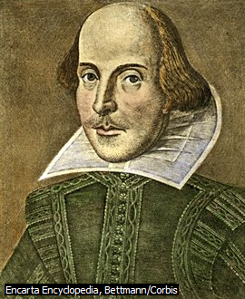
Language point

Slide 127
Language point
King James Bible: a version of the Bible published in England in 1611 and authorized by James I for use in the Church of England 钦定英译本《圣经》

Slide 128
Language point
perfect: without errors, flaws, or faults 完美的
in perfect condition
She would be perfect for the job.
She strives for perfection in everything.
The cooking was close to perfection.
The dress fitted her to perfection. 完美极了

Slide 129
Language point
familiar: with a thorough knowledge and good understanding of something 熟悉的
Are you familiar with the theory?
Is this area familiar to you?
all too familiar
thoroughly familiar
Are you familiar with the details?
Thorough familiarity with English
She had to familiarize herself with the facts of the case.
Her father familiarized her with the rules of the game.

Slide 130
Language point
drop/fall/go/pass out of use: is no longer used 不再使用
The word “spake” dropped out of use in the modern English.

Slide 131
Language point
prayer: a spoken or unspoken address to God, a deity, or a saint. It may express praise, thanksgiving, confession, or a request for something such as help or somebody‘s well-being. 祈祷
to pray devoutly/fervently/silently
to pray to God for good health
to offer/say/utter prayer
to answer a prayer
a fervent/silent prayer
to offer a prayer for peace

Slide 132
Language point
quotation: the quoting of what somebody has said or written 引文
to give a quotation from Shakespeare
a direct quotation
to quote directly
She quoted several verses to us.
She loves to quote from Shakespeare.
to quote a passage from the Bible
quotation marks

Slide 133
Language point
countermove: to act in response to an opponent‘s action, e.g. in a game 反对的运动
countermovement on the battlefield
to countermove against the enemy

Slide 134
Language point
half-hearted: with little enthusiasm and no real interest in the result 三心二意的
He is always half-hearted in the pursuit of love.
Don’t keep a half-hearted attitude towards your work.

Slide 135
Language point
regulate: to control something and bring it to the desired level, e.g. by adjusting the output of a machine or by imposing restrictions on the flow of something 规范
to adopt/enact/apply/enforce/observe/violate a regulation
government/health/school/security/traffic regulation
regulative rules

Slide 136
Language point
polish: to make something more refined, elegant, or complete, or become more refined, elegant, or complete 美化；润色
to polish a speech
Before submitting your paper, you should polish it.
to give sth. a polish
furniture/shoe polish

Slide 137
Language point
prune: to remove something considered unnecessary or unwanted 修剪；裁剪
to prune the essay of what is superfluous
a pruned style
to prune the budget
to prune public spending

Slide 138
Language point
restrict: to keep something within fixed limits 限制
The entry is restricted to members only.
The chair restricted discussion to items on the official agenda.
She restricted herself to two meals a day.
to impose restrictions on
to lift a restriction
restrictions on the export of high-technology goods

Slide 139
Language point
proliferate: to increase greatly in number 扩散
Tropical vegetation proliferates.
Motorcycles proliferated when gasoline prices rose.
to prevent the proliferation of nuclear weapons
nuclear proliferation

Slide 140
Language point
academy: the academic community, especially scholars at colleges and universities 学院
fencing/military/naval/riding academy
an academy of fine arts

Slide 141
Language point
succeed: to manage to do what is planned or attempted 成功
We succeeded in persuading them to change their decision.
She succeeded me as class treasurer.
She succeeded to the throne.

Slide 142
Language point
attitude: an opinion or general feeling about something 态度
a positive attitude to change
to adopt an attitude
to maintain/retain an attitude
belligerent/casual/defiant/hands-off/liberal/
negative/objective/optimistic/positive/
realistic/religious/reverent/sympathetic/
uncertain/watch-and-wait attitude

Slide 143
Language point
in part: to an extent but not completely 部分
In part he was right.
She is responsible for the accident in small part.
He is to blame in large part.

Slide 144
Language point
fix: to make something stable, firm, or secure, or become so 固定
She fixed her gaze on him.
to fix one’s attention on
Fix a drink for me.
They are fixing to eat. 准备吃饭
to be in a fix
a fine/nice/pretty fix 反语 糟透的处境
to get/need a fix 注射

Slide 145
Language point
gradual: proceeding or developing slowly by steps or degrees 逐渐的；逐步的
a gradual improvement
A child’s growth into an adult is gradual.
a gradual change for the better
to graduate from
undergraduate
graduate

Slide 146
Language point
Samuel Johnson: English lexicographer and writer Samuel Johnson ranked as one of the most important literary figures of the 18th century. Nicknamed both Dictionary Johnson and the Great Cham of Literature (Cham is an archaic word meaning Khan), Johnson compiled and wrote the Dictionary of the English Language, published in 1755. Johnson later served as the subject of one of the greatest biographies ever written, James Boswell’s Life of Samuel Johnson (1791). 约翰逊

Slide 147
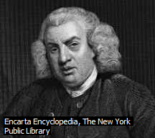
Language point

Slide 148
Language point
steady: fixed, stable, or not easily moved 稳固的
Can you hold the ladder so that it's steady?
to go steady with sb. 确定恋爱关系
Ready, steady, go!
a steady growth of economy
unsteady life
steadiness

Slide 149
Language point
revise: to change a previous estimate in order to make it more accurate or realistic 修改
He had to do some revision for the examination.
to make a revision
revised version

Slide 150
Language point
dominate: to have control, power, or authority over somebody or something 支配；控制
Who on earth dominates the party?
to challenge the US domination of other countries

Slide 151
Language point
before long: before much time passes 不久；行将
Class will be over before long.

Slide 152
Language point
compile: to create something by putting together things that have been gathered from various places 编撰
to compile statistical data
to make/do a compilation
a compilation of dictionary
to compile a dictionary from various sources
dictionary compiler

Slide 153
Language point
labor: a piece of work of a particular type, especially a difficult or long one (often used in the plural) 工作；劳动
a labor of love
manual/physical labor
painstaking labor
sweatshop labor
division of labor
Democratic countries forbid forced labor.
hard labor
Slave labor has been outlawed.
to labor as a migrant worker

Slide 154
Language point
numerous: many in number 大量的
Numerous books have been collected for this project.
Your days are numbered/counted. 指日可待
to enumerate a list of books you are supposed to read

Slide 155
Language point
commercial: relating to the buying and selling of goods or services 商业的
to sponsor a commercial 商业广告
radio/TV commercial
to carry on/engage in commerce 商业活动
oversea commerce
Commerce between Germany and Italy.
the development of commerce with Asia
the world of commerce

Slide 156
Language point
invention: the creation of something new 发明
to come up with an invention
to work on an invention
to patent an invention
to register an invention
an ingenious invention
to invent a new gadget
inventive
inventor

Slide 157
Language point
scholarship: a body of learning on an academic subject 学术
a review of German scholarship on the topic
to foster/promote scholarship
productive scholarship
scientific scholarship
solid/sound/thorough scholarship
to apply for scholarship 奖学金
to receive a scholarship for language study
She won a scholarship to study abroad.
scholarly journal

Slide 158
Language point
dissect: to cut and separate the parts of animal or plant specimens for scientific or medical study 分解
to dissect the body for medical research
dissection of human bodies
to dissect a frog

Slide 159
Language point
parse: to describe the grammatical role of a word in a sentence, or undergo this process 描述语法角色

Slide 160
Language point
in practice: in the real world and under everyday conditions, as opposed to in theory 实际上
in theory and in practice

Slide 161
Language point
superimpose: to place something such as a transparent image on or over something else, often with the result that both things appear simultaneously, although one may partially obscure the other 置于……之上
The party emblem was superimposed on the state coat of arms. 党徽放到国家盾形纹章之上
superimposition

Slide 162
Language point
signal: an action, gesture, or sign used as a means of communication 符号；信号
to flash/send a signal
a clear/unmistakable/smoke signal
Indians used to send up smoke signals.
to signal wildly 乱发信号
They signaled their position to us.

Slide 163
Language point
work out: to solve a problem or find an answer to a question by reasoning or calculation 解决；算出
The boy spent five minutes working out the puzzle.
Can you work out the physics problem?

Slide 164
Language point
instructive: providing useful information or insight into something 教益的
It will be instructive to analyze the results.
Instruction
to instruct sb. to do sth.
instructor

Slide 165
Language point
logic: the branch of philosophy that deals with the theory of deductive and inductive arguments and aims to distinguish good from bad reasoning 逻辑
to apply/use a logic
clear/cold logic
irrefutable logic
simple logic
formal logic
symbolic logic
logical reasoning
illogical speech

Slide 166
Language point
principal: first or among the first in importance or rank 主要的
principal figure in the strike
principal reason
school principal

Slide 167
Language point
tend: to be generally inclined or likely to react or behave in a particular way, or be in the habit of doing something 倾向
Their music tends towards jazz.
He tends to exaggerate.
tendency
suicidal tendency

Slide 168
Language point
obscure: to make something unclear, indistinct, or hidden 遮挡；掩盖
The meaning was obscure to me.
to emerge/rise from obscurity
to sink into obscurity
to live in obscurity
to disappear obscurity

Slide 169
Language point
tremendous: extremely large, powerful, or great 巨大的；极大的；惊人的
There was a tremendous clap of thunder.
tremendous sound/speed
tremendous amount of money
tremendous effort

Slide 170
Language point
expansion: the process of increasing, or increasing something, in size, extent, scope, or number 扩展；扩张
This site does not give us enough room for expansion.
to expand an article into a book
to expand on a topic
expansive acquaintances/lake/view

Slide 171
Language point
minor: relatively small in quantity, size, or degree 数量少的
minority
small/ethnic/religious minority
We were in the minority.
in a minority of cases
to serve minors
This bar does not serve minors
No minors.
to minor in French

Slide 172
Language point
specify: to state or identify something in detail or explicitly 确定；明确
Can you specify a date when the order will be delivered?
to specify sb. by name
The instructions specify how the medicine is to be taken.

Slide 173
Language point
difference: a feature that distinguishes one person or thing from another 差别；差异
Can you spot the differences between the two?
to make a difference
It doesn’t make any difference whether you go or stay.
to tell the difference
to see the difference
to set aside differences

Slide 174
Language point
confident: certain of having the ability, judgment, and resources needed to succeed 有信心的
to be confident of success
She was confident that she would succeed.
to take sb. into confidence 把某人当成知己
She told it to me in strictest confidence.

Slide 175
Language point
communication: the exchange of information between people, e.g. by means of speaking, writing, or using a common system of signs or behavior 沟通；交流
official communication
personal communication
communication from
to cut off/establish communications
mass communications
She has been in communication with her family.

Slide 176
Language point
unintelligible: difficult or impossible to understand 难以理解的
The script was unintelligible.

